Slide 1
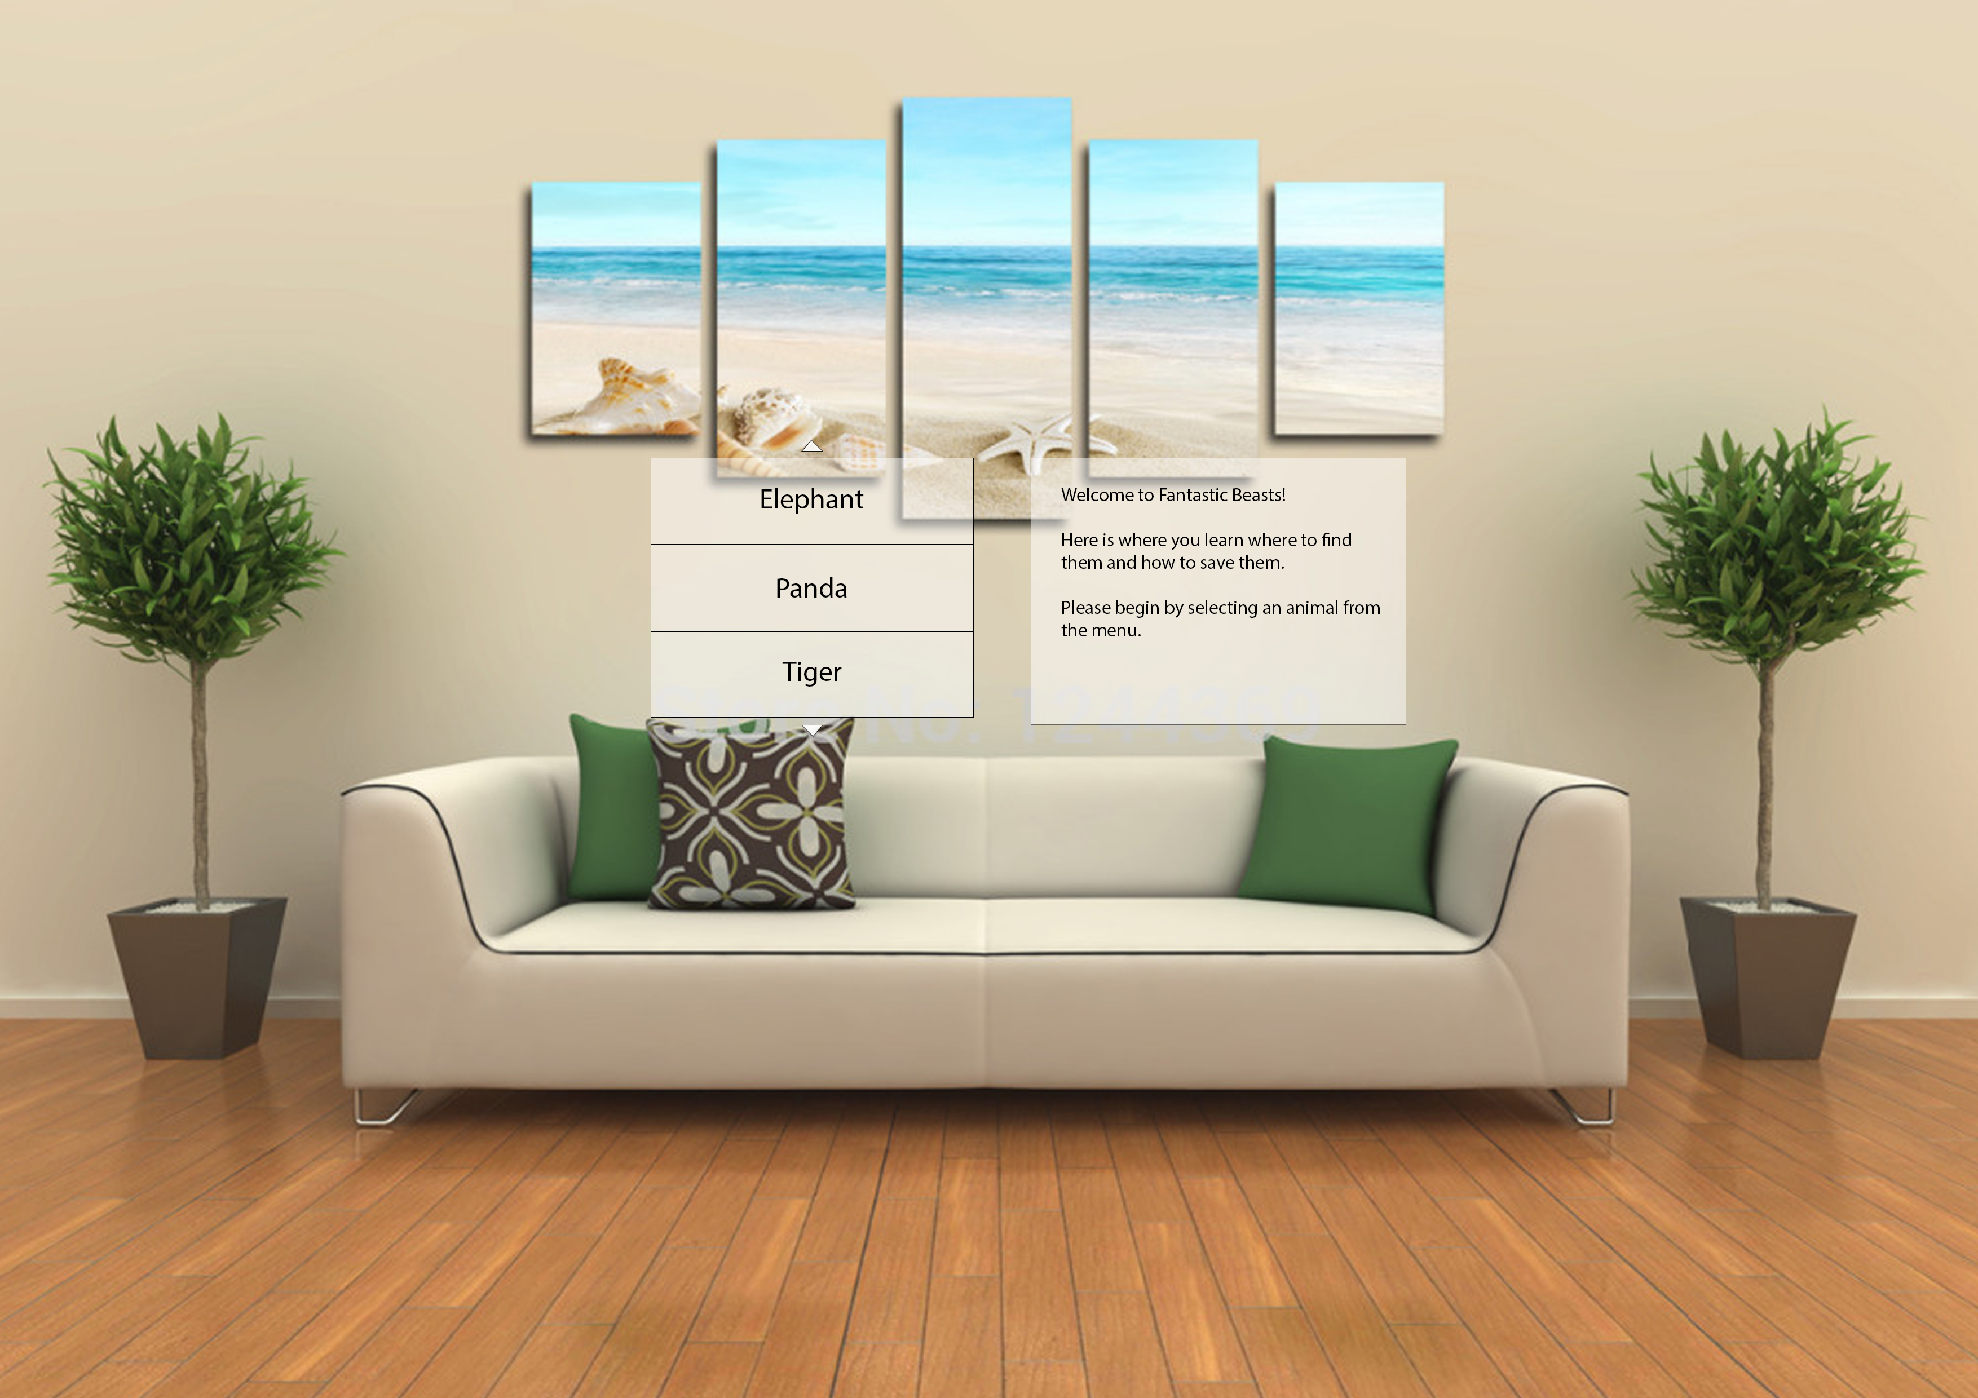
Begin by Reading this and then Selecting an animal of your choice

Slide 2
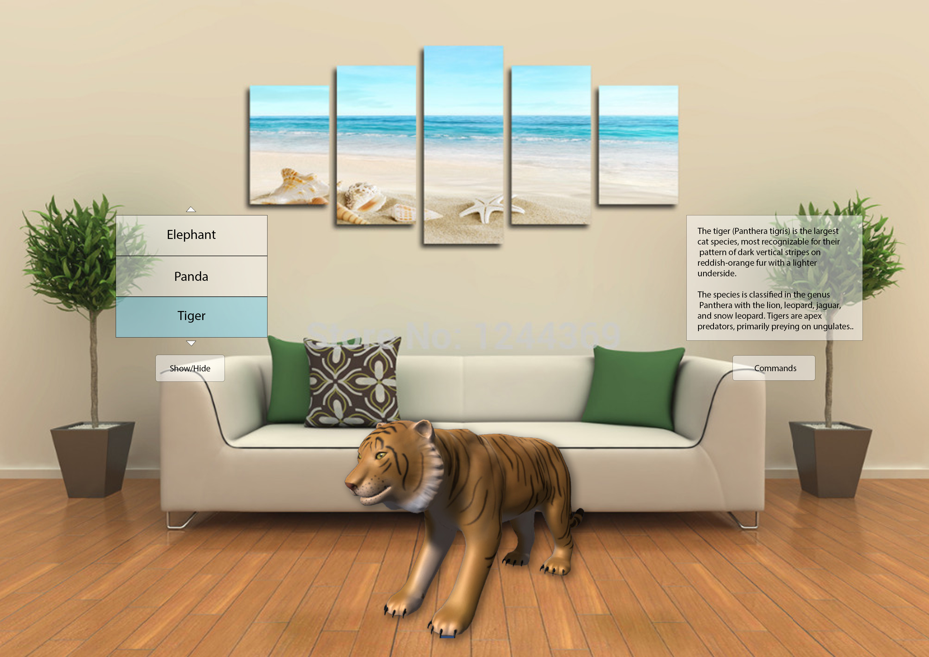
Educational Information about the selected animal is displayed here
When an animal is first selected the
UI expands
Various buttons appear
And the animal is populated here in the environment

Slide 3
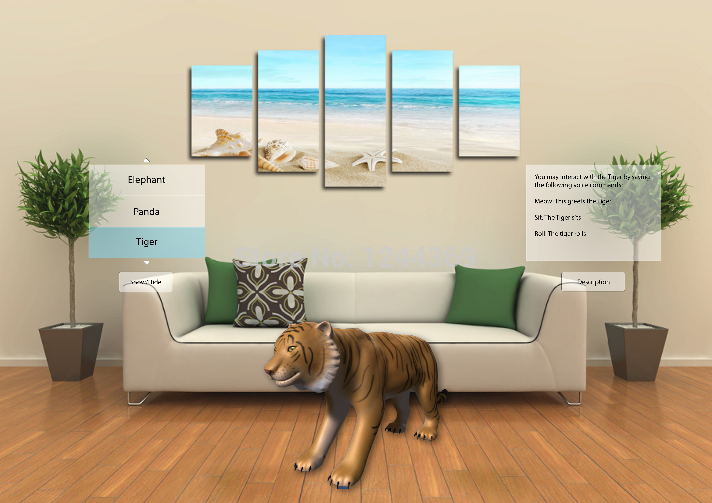
Animal commands are now displayed here, they are voice activated
When the command button is clicked, the button changes
to the description button so you can navigate back

Slide 4
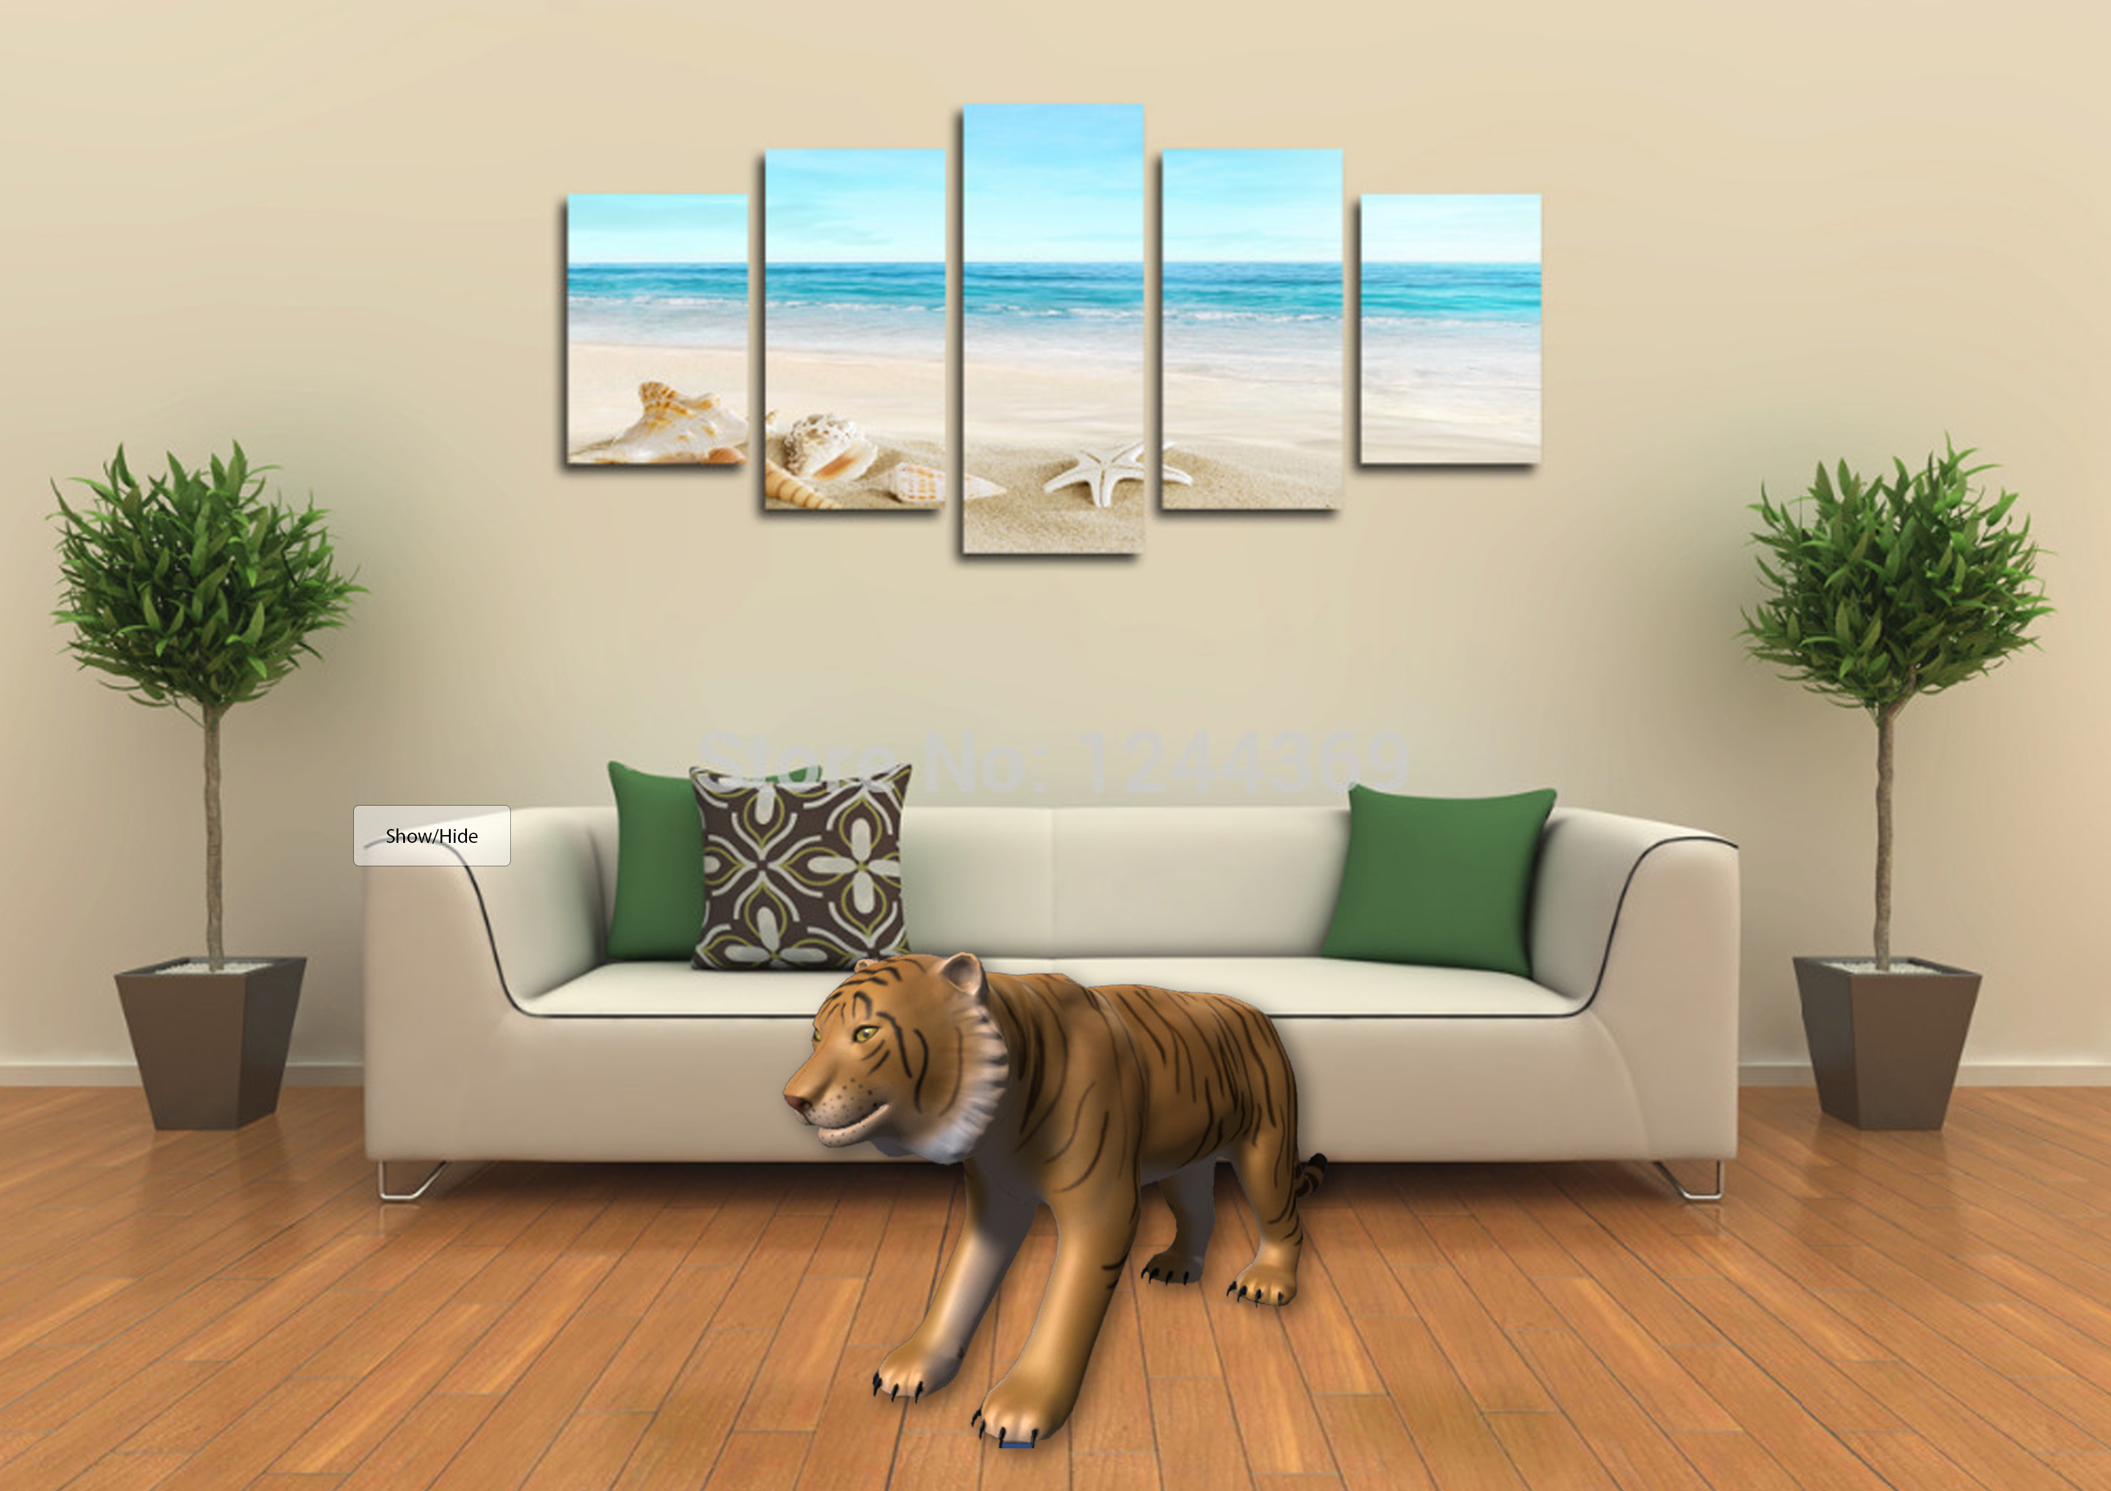
By clicking this button it hides all UI except this button, clicking it again reveals the UI
This allows for a more personal experience and interaction between the user and the animal

